Slide 1

CUI Abbottabad
Department of Computer Science
Object Oriented Programming
Lecture No. 1
Introduction to OOP
COMSATS University Islamabad, Abbottabad Campus

Slide 2
Evolution of OOP
OOP is being used for designing large and complex applications.
Before OOP many programming approaches existed which had many drawbacks. These programming approaches have been passing through revolutionary phases.
Initially for designing small and simple programs, the machine language was used.
Next came the Assembly Language which was used for designing larger programs.

Slide 3
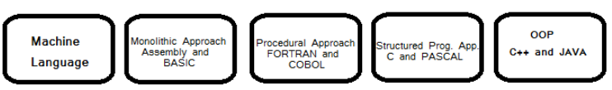
Evolution of OOP contd.
Both machine and Assembly languages are machine dependent.
Next came Procedural Programming Approach which enabled us to write larger and hundred lines of code.
In 1970, a new programming approach called Structured Programming approach was developed for designing medium sized programs.
In 1980's the size of programs kept increasing so a new approach known as OOP was invented.

Slide 4
Difference between OOP approach and Structured approach
The Structured Programming allows developing a program using a set of modules or functions.
While Object Oriented Programming allows constructing a program using a set of objects and their interactions.
In Object Oriented Programming, Programs are divided into small entities called objects which is more secure as having data hiding feature.
Structured Programming is less secure as there is no way of data hiding.

Slide 5
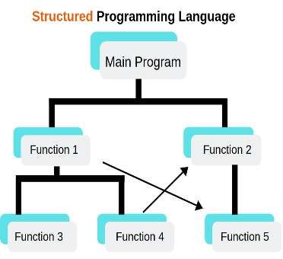
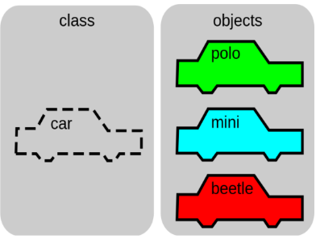
Structured Programming
Object Oriented Programming

Slide 6
Why Java?
Java enables users to develop and deploy applications on the Internet for servers, desktop computers, and small hand-held devices.
The future of computing is being profoundly influenced by the Internet, and Java promises to remain a big part of that future.
Desktop applications such as window accessories, web applications etc.
Enterprise applications such as Banking, mobile app.
Embeded systems, Robotics and Games

Slide 7
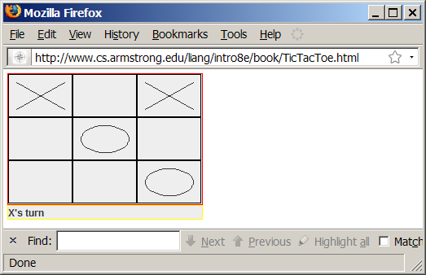
Examples of Java’s Versatility (Applets)

Slide 8
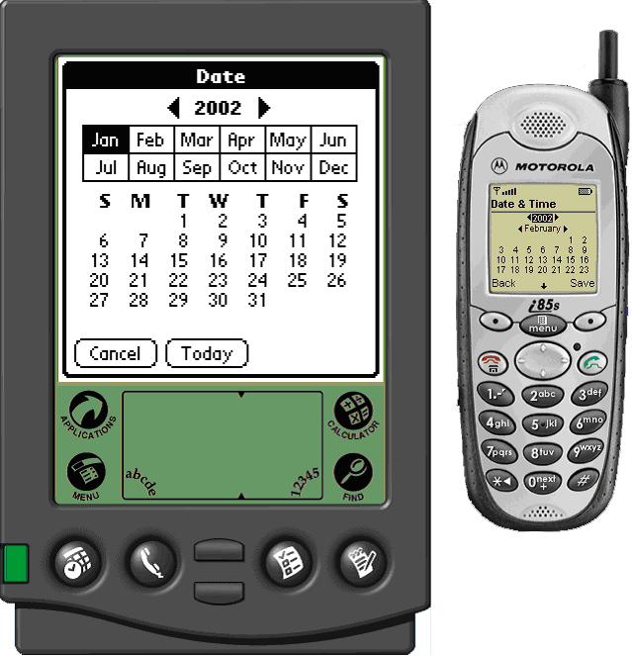
PDA and Cell Phone

Slide 9
Java’s History
James Gosling and Sun Microsystems
Java, May 20, 1995, Sun World
HotJava
  The first Java-enabled Web browser
Early History Website:
http://java.sun.com/features/1998/05/birthday.html

Slide 10
Characteristics of Java
Java Is Simple
Java Is Object-Oriented
Java Is Distributed
Java Is Interpreted
Java Is Robust
Java Is Secure
Java Is Architecture-Neutral
Java Is Portable
Java's Performance
Java Is Multithreaded
Java Is Dynamic
www.cs.armstrong.edu/liang/intro8e/JavaCharacteristics.pdf

Slide 11
Characteristics of Java
Java Is Simple
Java Is Object-Oriented
Java Is Distributed
Java Is Interpreted
Java Is Robust
Java Is Secure
Java Is Architecture-Neutral
Java Is Portable
Java's Performance
Java Is Multithreaded
Java Is Dynamic
Java is partially modeled on C++, but greatly simplified and improved. Some people refer to Java as "C++" because it is like C++ but with more functionality and fewer negative aspects.

Slide 12
Characteristics of Java
Java Is Simple
Java Is Object-Oriented
Java Is Distributed
Java Is Interpreted
Java Is Robust
Java Is Secure
Java Is Architecture-Neutral
Java Is Portable
Java's Performance
Java Is Multithreaded
Java Is Dynamic
Java is inherently object-oriented. Although many object-oriented languages began strictly as procedural languages, Java was designed from the start to be object-oriented. Object-oriented programming (OOP) is a popular programming approach that is replacing traditional procedural programming techniques.
One of the central issues in software development is how to reuse code. Object-oriented programming provides great flexibility, modularity, clarity, and reusability through encapsulation, inheritance, and polymorphism.

Slide 13
Characteristics of Java
Java Is Simple
Java Is Object-Oriented
Java Is Distributed
Java Is Interpreted
Java Is Robust
Java Is Secure
Java Is Architecture-Neutral
Java Is Portable
Java's Performance
Java Is Multithreaded
Java Is Dynamic
Distributed computing involves several computers working together on a network. Java is designed to make distributed computing easy. Since networking capability is inherently integrated into Java, writing network programs is like sending and receiving data to and from a file.

Slide 14
Characteristics of Java
Java Is Simple
Java Is Object-Oriented
Java Is Distributed
Java Is Interpreted
Java Is Robust
Java Is Secure
Java Is Architecture-Neutral
Java Is Portable
Java's Performance
Java Is Multithreaded
Java Is Dynamic
You need an interpreter to run Java programs. The programs are compiled into the Java Virtual Machine code called bytecode. The bytecode is machine-independent and can run on any machine that has a Java interpreter, which is part of the Java Virtual Machine (JVM).

Slide 15
Characteristics of Java
Java Is Simple
Java Is Object-Oriented
Java Is Distributed
Java Is Interpreted
Java Is Robust
Java Is Secure
Java Is Architecture-Neutral
Java Is Portable
Java's Performance
Java Is Multithreaded
Java Is Dynamic
Java compilers can detect many problems that would first show up at execution time in other languages.
Java has eliminated certain types of error-prone programming constructs found in other languages.
Java has a runtime exception-handling feature to provide programming support for robustness.

Slide 16
Characteristics of Java
Java Is Simple
Java Is Object-Oriented
Java Is Distributed
Java Is Interpreted
Java Is Robust
Java Is Secure
Java Is Portable
Java's Performance
Java Is Multithreaded
Java Is Dynamic
Java implements several security mechanisms to protect your system against harm caused by stray programs.

Slide 17
Characteristics of Java
Java Is Simple
Java Is Object-Oriented
Java Is Distributed
Java Is Interpreted
Java Is Robust
Java Is Secure
Java Is Portable
Java's Performance
Java Is Multithreaded
Java Is Dynamic

Slide 18
Characteristics of Java
Java Is Simple
Java Is Object-Oriented
Java Is Distributed
Java Is Interpreted
Java Is Robust
Java Is Secure
Java Is Portable
Java's Performance
Java Is Multithreaded
Java Is Dynamic
Write once, run anywhere
With a Java Virtual Machine (JVM), you can write one program that will run on any platform.

Slide 19
Characteristics of Java
Java Is Simple
Java Is Object-Oriented
Java Is Distributed
Java Is Interpreted
Java Is Robust
Java Is Secure
Java Is Portable
Java's Performance
Java Is Multithreaded
Java Is Dynamic
Java’s performance Because Java is architecture neutral, Java programs are portable. They can be run on any platform without being recompiled.

Slide 20
Characteristics of Java
Java Is Simple
Java Is Object-Oriented
Java Is Distributed
Java Is Interpreted
Java Is Robust
Java Is Secure
Java Is Portable
Java's Performance
Java Is Multithreaded
Java Is Dynamic
Multithread programming is smoothly integrated in Java, whereas in other languages you have to call procedures specific to the operating system to enable multithreading.

Slide 21
Characteristics of Java
Java Is Simple
Java Is Object-Oriented
Java Is Distributed
Java Is Interpreted
Java Is Robust
Java Is Secure
Java Is Portable
Java's Performance
Java Is Multithreaded
Java Is Dynamic
Java was designed to adapt to an evolving environment. New code can be loaded on the fly without recompilation. There is no need for developers to create, and for users to install, major new software versions. New features can be incorporated transparently as needed.

Slide 22
JDK Versions
JDK 1.02 (1995)
JDK 1.1 (1996)
JDK 1.2 (1998)
JDK 1.3 (2000)
JDK 1.4 (2002)
JDK 1.5 (2004) a. k. a. JDK 5 or Java 5
JDK 1.6 (2006) a. k. a. JDK 6 or Java 6
JDK 1.7 (possibly 2010) a. k. a. JDK 7 or Java 7
JDK 1.8 and above

Slide 23
JDK Editions
Java Standard Edition (J2SE)
  J2SE can be used to develop client-side standalone applications or applets.
Java Enterprise Edition (J2EE)
  J2EE can be used to develop server-side applications such as Java servlets and Java ServerPages.
Java Micro Edition (J2ME).
  J2ME can be used to develop applications for mobile devices such as cell phones.

Slide 24
Popular Java IDEs
NetBeans Open Source by Sun
Eclipse Open Source by IBM
TextPad (Any latest ver)

Slide 25
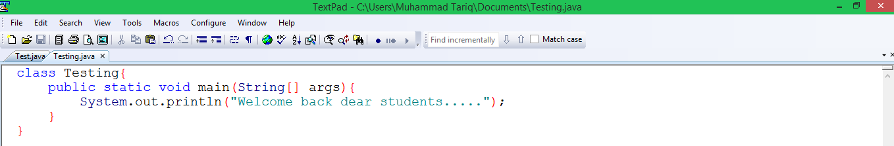
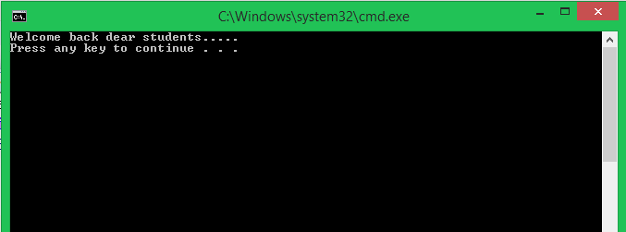
A Simple Java Program (TextPad)

Slide 26
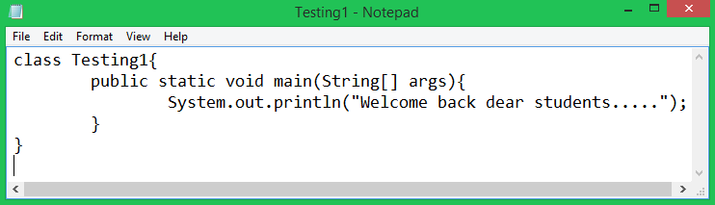
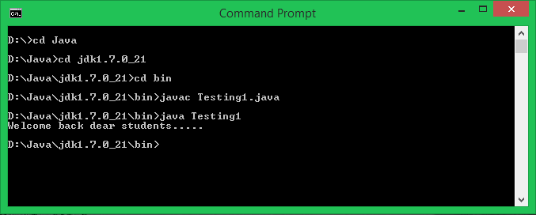
Creating and Editing Using NotePad

Slide 27
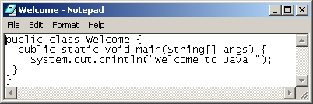
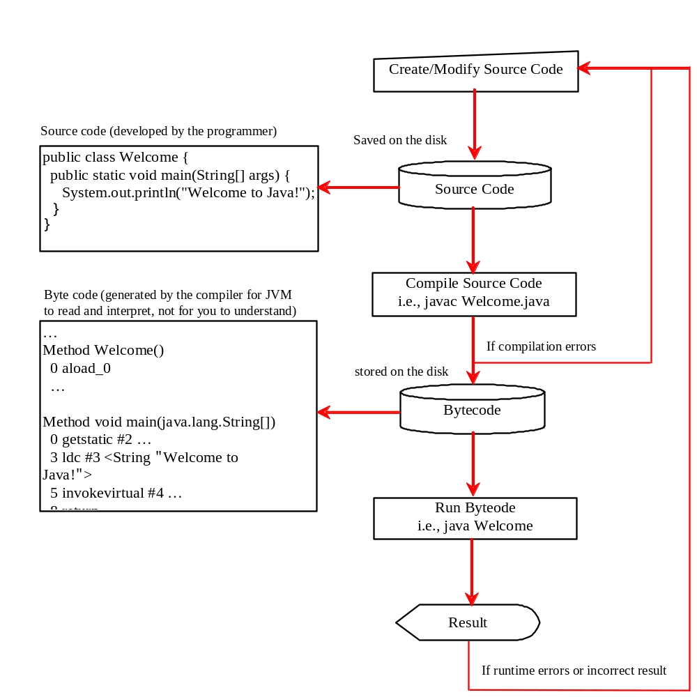
Creating, Compiling, and Running Programs

Slide 28
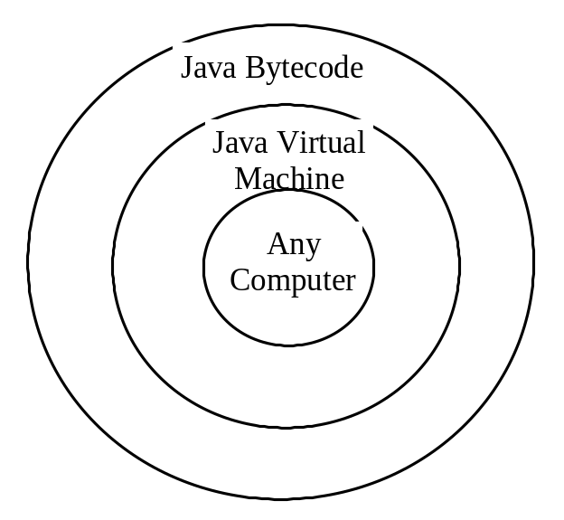
Compiling Java Source Code
You can port a source program to any machine with appropriate compilers. The source program must be recompiled, however, because the object program can only run on a specific machine. Nowadays computers are networked to work together. Java was designed to run object programs on any platform. With Java, you write the program once, and compile the source program into a special type of object code, known as bytecode. The bytecode can then run on any computer with a Java Virtual Machine, as shown below. Java Virtual Machine is a software that interprets Java bytecode.

Slide 29
Trace a Program Execution
Enter main method
//This program prints Welcome to Java!
public class Welcome {
public static void main(String[] args) {
System.out.println("Welcome to Java!");
}
}

Slide 30
Trace a Program Execution
Execute statement
//This program prints Welcome to Java!
public class Welcome {
public static void main(String[] args) {
System.out.println("Welcome to Java!");
}
}

Slide 31

Trace a Program Execution
//This program prints Welcome to Java!
public class Welcome {
public static void main(String[] args) {
System.out.println("Welcome to Java!");
}
}
print a message to the console

